Slide 1
Shortest Path Problem
Dikjstra’s Algorithm

Slide 2
Shortest Path Problems
What is shortest path ?
shortest length between two vertices for an unweighted graph:
smallest cost between two vertices for a weighted graph:
B
B
210
A
A
450
60
190
C
unweighted graph
C
weighted graph
200
130
D
D
E
E

Slide 3
Shortest Path Problems
How can we find the shortest route between two points on a map?
Model the problem as a graph problem:
Road map is a weighted graph:
vertices = cities
edges = road segments between cities
edge weights = road distances
Goal: find a shortest path between two vertices (cities)

Slide 4
Shortest Path Problems
Input:
Directed graph G = (V, E)
Weight function w : E → R
Weight of path p = ⟨v₀, v₁, . . . , v_{k}⟩
Shortest-path weight from u to v:
δ(u, v) = min w(p) : u v if there exists a path from u to v
∞ otherwise
Shortest path u to v is any path p such that w(p) = δ(u, v)
t
x
3
6
9
3
4
s
0
2
1
2
7
5
3
5
11
6
y
z
p
Notes:
Optimization problem
There can be multiple shortest paths i.e optimal solutions

Slide 5
Variants of Shortest Paths
Single-source shortest path
G = (V, E) ⇒ find a shortest path from a given source vertex s to each vertex v ∈ V
Single-destination shortest path
Find a shortest path to a given destination vertex t from each vertex v
Reverse the direction of each edge ⇒ single-source
Single-pair shortest path
Find a shortest path from u to v for given vertices u and v
Solve the single-source problem
All-pairs shortest-paths
Find a shortest path from u to v for every pair of vertices u and v
Notes:
If graph is undirected, single-source is same as single destination. Else reverse the edges, and now treat the destination vertex as a source vertex

Slide 6
Optimal Substructure of Shortest Paths
Given:
A weighted, directed graph G = (V, E)
A weight function w: E → R,
A shortest path p_{1k} = ⟨v₁, v₂, . . . , v_{k}⟩ from v₁ to v_{k}
A subpath of p: p_{ij} = ⟨v_{i}, v_{i+1}, . . . , v_{j}⟩, with 1 ≤ i ≤ j ≤ k
Then: p_{ij} is a shortest path from v_{i} to v_{j}
Proof: p = v₁ v_{i} v_{j} v_{k}
w(p) = w(p_{1i}) + w(p_{ij}) + w(p_{jk})
Assume ∃ p_{ij}’ from v_{i} to v_{j} with w(p_{ij}’) < w(p_{ij})
⇒ w(p’) = w(p_{1i}) + w(p_{ij}’) + w(p_{jk}) < w(p) contradiction!
v_{j}
p_{ij}
p_{jk}
v₁
p_{1i}
p_{ij}’
v_{k}
v_{i}
p_{1i}
p_{ij}
p_{jk}
Notes:
Theorem: Sub-paths of shortest path are also shortest paths.

Slide 7
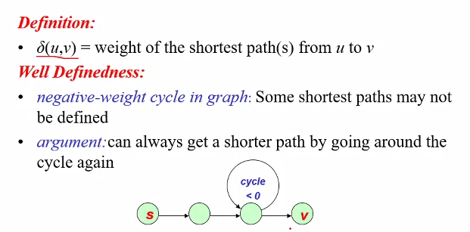
Representation
Notes:
If sum of edges of a cycle is negative, it is called negative-weight cycle
If this negative cycle is reachable from the source vertex, we can visit this infinitely many times and make the path shorter and shorter

Slide 8
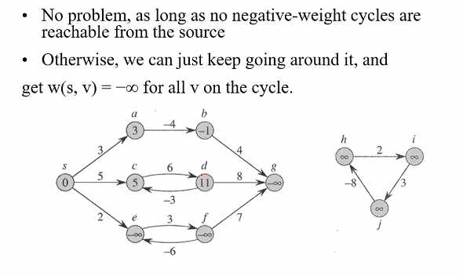
Negative-edge weights
Notes:
So length of sucha path is infinite and to compute it I need to execute infinite instructions (or execute one instruction infinite many times)

Slide 9
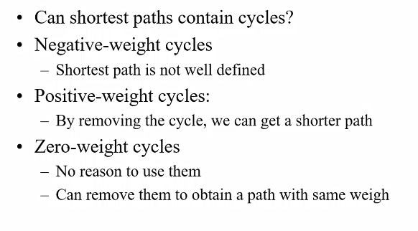
Cycles

Slide 10
Shortest-Path Representation
For each vertex v ∈ V:
d[v] = δ(s, v): a shortest-path estimate
Initially, d[v]=∞
Reduces (reaches close to δ(s, v)) as algorithms progress
π[v] = predecessor of v on a shortest path from s
If no predecessor, π[v] = NIL
π induces a tree—shortest-path tree
Shortest paths & shortest path trees are not unique
t
x
3
6
9
3
4
s
0
2
1
2
7
5
3
5
11
6
y
z
Notes:
δ(s, v) or d[v] is only telling us the value or the weight of the path, but we need to know which edges to traverse to achieve this weight value, that’s why we define the predecessor

Slide 11
Initialization
Alg.: INIT (G, s)
for each v ∈ V
do d[v] ← ∞
π[v] ← NIL
d[s] ← 0
All the shortest-paths algorithms start with INIT
Maintain d[v] for each v ∈ V
d[v] is called the shortest-path weight estimate and it is the upper bound on δ(s, v)
Notes:
The distance to be travelled to go to source vertex from source vertex is zero so d[s]=0

Slide 12
Relaxation
Relaxing an edge (u, v) = testing whether we can improve the shortest path to v found so far by going through u
If d[v] > d[u] + w(u, v)
we can improve the shortest path to v
⇒ update d[v] and π[v]
s
s
u
v
u
v
After relaxation:
d[v] ≤ d[u] + w(u, v)
5
2
9
5
2
6
RELAX(u, v, w)
RELAX(u, v, w)
u
v
u
v
5
2
7
5
2
6

Slide 13
RELAX(u, v)
if d[v] > d[u] + w(u, v)
then d[v] ← d[u] + w(u, v)
π[v] ← u
All the single-source shortest-paths algorithms
start by calling INIT
then relax edges
The algorithms differ in the order and how many times they relax each edge (it affects the correctness and time complexity of the algorithm)

Slide 14
Single Source Shortest Path Problem
Given a graph and a start vertex s
Determine distance of every vertex from s
Identify shortest paths to each vertex
Express concisely as a “shortest paths tree”
Each vertex has a pointer to a predecessor on shortest path
1
u
u
5
1
2
3
x
s
x
s
3
4
3
v
v
Notes:
Source vertex is root of tree
Each node points to its predecessor.

Slide 15
Using BFS
Generalization of BFS to handle weighted graphs
Direct Graph G = ( V, E ), edge weight fn ; w : E → R
In BFS w(e)=1 for all e ∈ E
Weight of path p = v₁ → v₂ → … → v_{k} is
w( p) = ∑w(v_{i} , v_{i+1} )
i=1
k −1

Slide 16
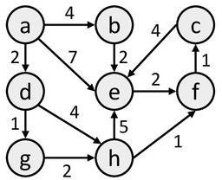
Why BFS is not Enough
Breadth-first visit order is “cautious” in the sense that it examines every path of length i before going on to paths of length i+1
Breadth-first search does not work!
Minimum number of hops does not mean minimum distance.
BFS will yield a, e, f as SP between a and f
a, d, g, h, f has lower distance
Notes:
BFS actually prioritizes the nodes which are fewer hops away.
We should consider the forward edges of those nodes which are at shortest distance from the start vertex
In BFS, we added all the nodes, which were one hop away, to a queue and then visited them one by one.
But now, in case of weighted graph, we need to prioritize the vertices. (by their distance from the source vertex)
For that, we can use priority queue instead of fifo queue, and we’ll give priority to the node which is closest to the start node

Slide 17
A Greedy Algorithm
Assume that every node is infinitely far away from the source.
i.e., every node is ∞ miles away from s (except s, which is 0 miles away).
Now perform something similar to breadth-first search, and optimistically guess that we have found the best path to each node as we encounter it.
If we later discover we are wrong and find a better path to a particular node, then update the distance to that node (edge Relaxation).

Slide 18
Intuition Behind Dijkstra’s Algorithm
For our SP problem, we can start by guessing that every node is ∞ miles away.
Mark each node with this guess.
Find all verices/cities one hop away from s, and check whether the distance is less than what is currently marked for that node.
If so, then revise the guess.
Continue for 2 hops, 3 hops, etc.

Slide 19
Dijkstra’s Algorithm For Shortest Paths
Assumes no negative-weight edges.
Maintains a set S of vertices whose SP from s has been determined.
3
1
_{y} 4
1
x ₂
2
Repeatedly selects u in V–S with minimum SP estimate (greedy choice).
Store V–S in priority queue Q. Like BFS: If all edge weights are equal, then use BFS, otherwise use
this algorithm (note: BFS uses FIFO)
1 _{u}
0
s
1
4
₂ 2
2
v
3
z 5
Notes:
After selecting the vertex which is closest to source vertex, we apply edge relaxation on edges of that vertex to see if we can compute shortest path of one of its neighbor (by lemma 4)

Slide 20
Dijkstra’s Algorithm For Shortest Paths
x is selected, then its edges are relaxed.
3
1
_{y} 3
1
x ₂
2
1 _{u}
0
s
1
4
₂ 2
2
v
3
z 4
Notes:
After selecting the vertex which is closest to source vertex, we apply edge relaxation on edges of that vertex to see if we can compute shortest path of one of its neighbor (by lemma 4)

Slide 21
Dijkstra's Algorithm
Similar to Prim's MST algorithm
Start with source node s and iteratively construct a tree rooted at s
Each node keeps track of tree node that provides cheapest path from s (not just cheapest path from any tree node)
At each iteration, include the node whose cheapest path from s is the overall cheapest

Slide 22
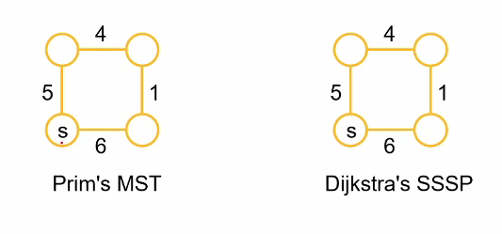
Prim's vs. Dijkstra's

Slide 23
Prim's vs. Dijkstra's
4
4
5
1
5
1
s
s
6
6
Prim's MST
Dijkstra's SSSP

Slide 24
Dijkstra’s Algorithm For Shortest Paths
DIJKSTRA(G, s)
INIT(G, s)
S←Ø > set of discovered nodes Q←V[G]
while Q ≠Ø do u←EXTRACT-MIN(Q) S←S U {u}
for each v ∈ Adj[u] do
RELAX(u, v) > May cause
> DECREASE-KEY(Q, v, d[v])
Notes:
Insert vertices in the queue on the basis of the distance value, from the source vertex.

Slide 25
Running Time Analysis
Look at different Q implementation, as did for Prim’s algorithm
Initialization (INIT) : Θ(V) time
While-loop:
EXTRACT-MIN executed |V| times
DECREASE-KEY executed |E| times
Time T = |V| x TE-MIN +|E| x TD-KEY
Notes:
We apply decrease key on outgoing neighbours

Slide 26
Running Time Analysis
Look at different Q implementation
Q TE-MIN TD-KEY TOTAL
Linear Unsorted Array: Binary Heap:
O(V)
O(1)
O(V²+E)
•
O(lgV)
O(logV)
O(VlgV+ElgV) = O(ElgV)

Slide 27
Example
u
v
∞
1
∞
10
9
2 3
s 0
4 6
5
7
∞
x
∞
y
2

Slide 28
Example
u : π=s
v
∞
1
10
10
9
2 3
s 0
4 6
5
7
5
x : π=s
∞
y
2

Slide 29
Example
u : π=x
v : π=x
14
1
8
10
9
2 3
s 0
4 6
5
7
5
x : π=s
7
y : π=x
2

Slide 30
Example
u : π=x
v : π=y
13
1
8
10
9
2 3
s 0
4 6
5
7
5
x : π=s
7
y : π=x
2

Slide 31
Example
u : π=x
v : π=u
9
1
8
10
9
2 3
s 0
4 6
5
7
5
x : π=s
7
y : π=x
2

Slide 32
Example
u : π=x
v : π=u
9
1
8
10
9
2 3
s 0
4 6
5
7
5
x : π=s
7
y : π=x
2

Slide 33
Triangle Inequality
Lemma 1: for a given vertex s ∈ V and for every edge (u,v) ∈ E,
δ(s,v) ≤ δ(s,u) + w(u,v)
Proof: shortest path s v is no longer than any other path.
in particular the path that takes the shortest path s v and
then takes cycle (u,v)
u v
s

Slide 34
Properties of Relaxation
Algorithms differ in
how many times they relax each edge, and
the order in which they relax edges
Question: How many times each edge is relaxed in BFS?
Answer: Only once!

Slide 35
Properties of Relaxation
Given:
An edge weighted directed graph G = ( V, E ) with edge
weight function (w:E → R) and a source vertex s ∈ V
G is initialized by INIT( G , s )
Lemma 2: Immediately after relaxing edge (u,v),
d[v] ≤ d[u] +w(u,v)
Lemma 3: For any sequence of relaxation steps over E,
the invariant d[v] ≥ δ(s,v) is maintained
once d[v] achieves its lower bound, it never changes.

Slide 36
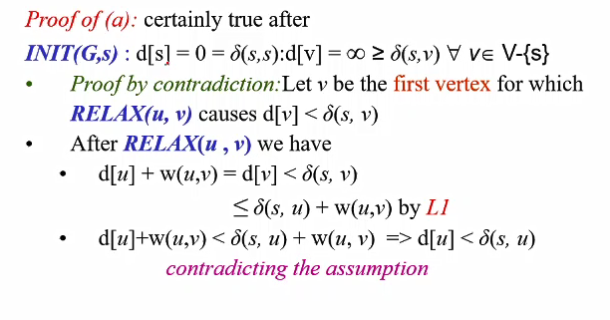
Properties of Relaxation
Notes:
Before any relaxation, the invariant is correct. If no path exists delta(s, v) is infinite and is equal to d[v]

Slide 37
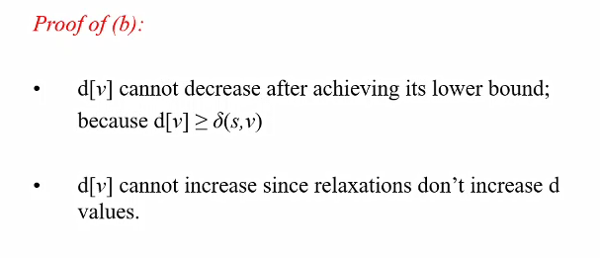
Properties of Relaxation
Notes:
D[v] is only changed during the relaxation operation. And is only changed when it the previous value is greater

Slide 38
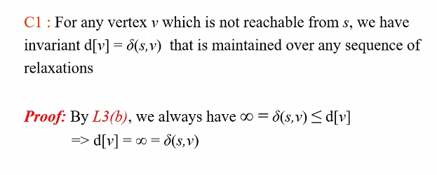
Properties of Relaxation

Slide 39
Properties of Relaxation
Lemma 4: Let s u →v be a shortest path from s to v for
some u,v ∈ V
Suppose that a sequence of relaxations including
RELAX(u,v) were performed on E
If d[u] = δ(s, u) at any time prior to RELAX(u, v)
then d[v] = δ(s, v) at all times after RELAX(u, v)

Slide 40
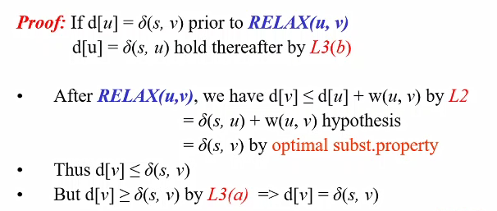
Properties of Relaxation

Slide 41
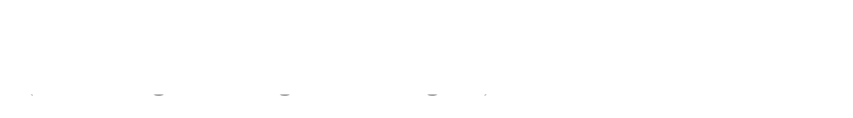

Correctness
Theorem: Upon termination, d[u] = δ(s, u) for all u in V (assuming non-negative weights).
Proof:
By Lemma3(b), once d[u] = δ(s, u) holds, it continues to hold.
We prove: For each u in V, d[u] = δ(s, u) when u is inserted in S.
Suppose not. Let u be the first vertex such that d[u] ≠ δ(s, u) when inserted in S.
Note that d[s] = δ(s, s) = 0 when s is inserted, so u ≠ s.
⇒ S ≠ ∅ just before u is inserted (in fact, s ∈ S).

Slide 42
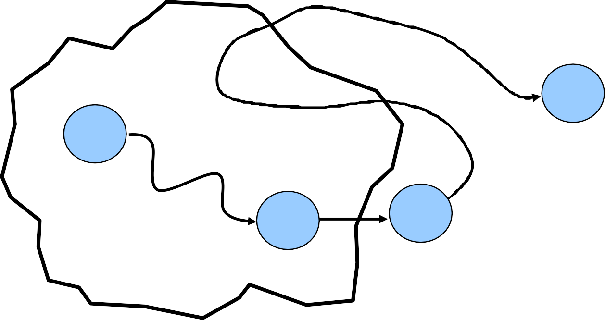
Proof (Continued)
Note that there exists a path from s to u, for otherwise d[u] = δ(s, u) = ∞.
⇒ there exists a SP from s to u. SP looks like this:
p₂
u
s
p₁
x
y
S
Notes:
Some vertices on this path belong to S and some to V\S

Slide 43
Proof (Continued)
Claim: d[y] = δ(s, y) when u is inserted into S.
We had d[x] = δ(s, x) when x was inserted into S. Edge (x, y) was relaxed at that time.
By Lemma4, this implies the claim.
Now, we have: d[y] = δ(s, y)
≤ δ(s, u)
≤ d[u]
, by Claim.
, nonnegative edge weights.
, by Lemma3(a).
Because u was added to S before y, d[u] ≤ d[y]. Thus, d[y] = δ(s, y) = δ(s, u) = d[u].
Contradiction.
Notes:
When u was extracted from the queue, u and y were both in the queue. We select that vertex from queue whose d value is smaller. So if we selected u before y, that means its d value id either less than d value of y, so we selected it or d[u]=d[y] and we selected u vertex randomly.

